Slide 1
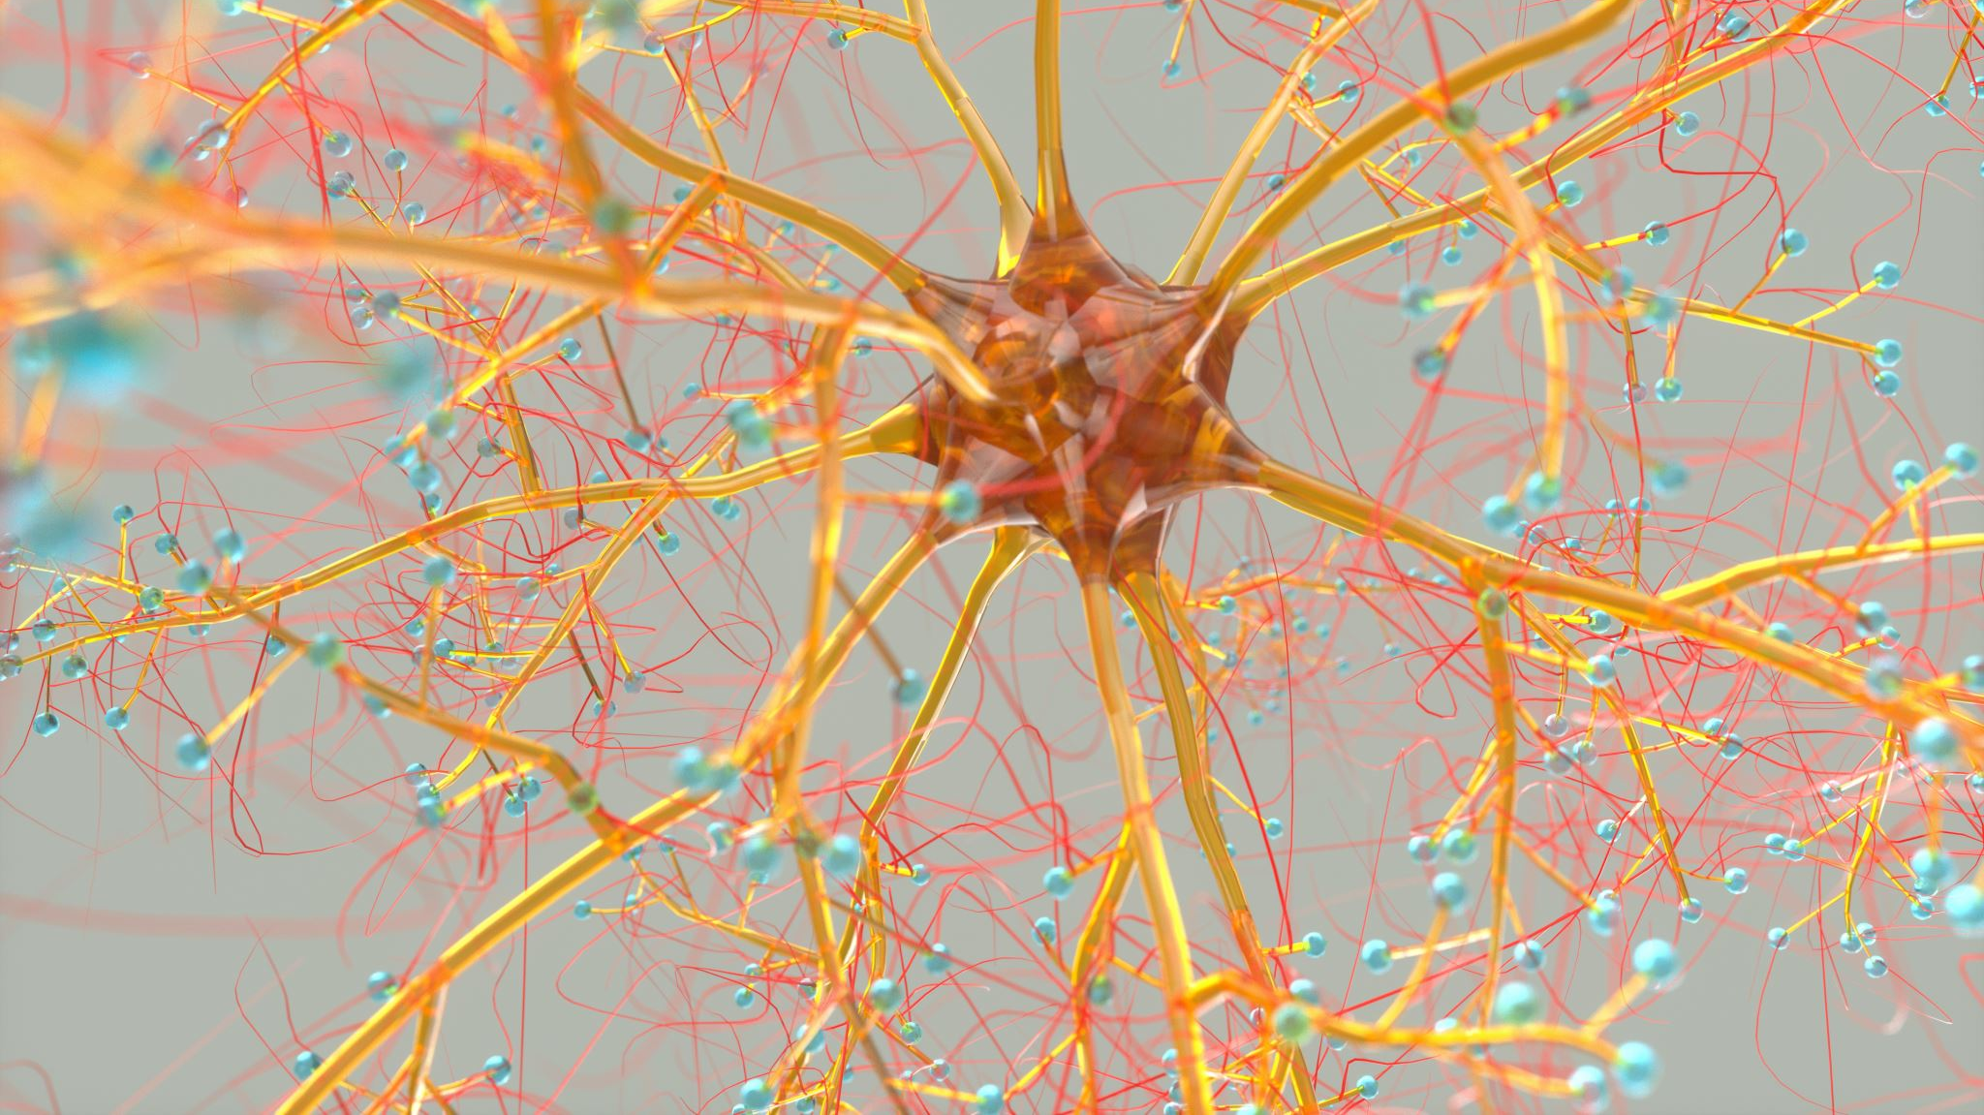
Convolutional Neural Network
Assignment_7 Image Classification
Kushum K C

Slide 2
Convolutional Neural Network (CNN)
a type of deep learning neural network commonly used in image classification
Keras library in python to differentiate between two types of images
Popular in learning complex pattern and features in input data such as image and video recognition
Useful in the data having noise and ambiguousness.

Slide 3

CNN cont.…
Commonly consists of layers:
Convolutional layer:
- performs mathematical operation (convolution) on input data
- learns to recognize pattern and features in Input, develops feature map
- dataset passed through a filter (trained to recognize specific feature in input)
Pooling layer: down samples the feature maps, reduces dimensionality of data
Flatten: converts output of convolutional layers to a single vector
Dense: fully connects every neuron in one layer to the next layer and uses activation function

Slide 4

Dataset for CNN
Pictures of road (both ridged and flexible pavement) located around Lamar University and vicinity (Beaumont)
Pictures contains both well conditioned (uncracked) road section and cracked road section.
Number of cracked and uncracked pictures is made roughly equal to avoid the bias towards one class.

Slide 5
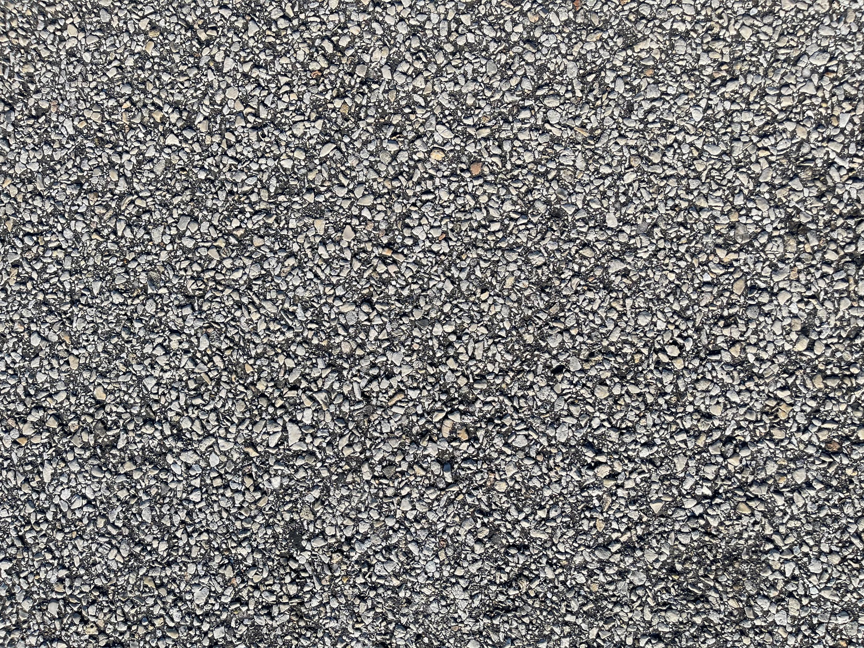
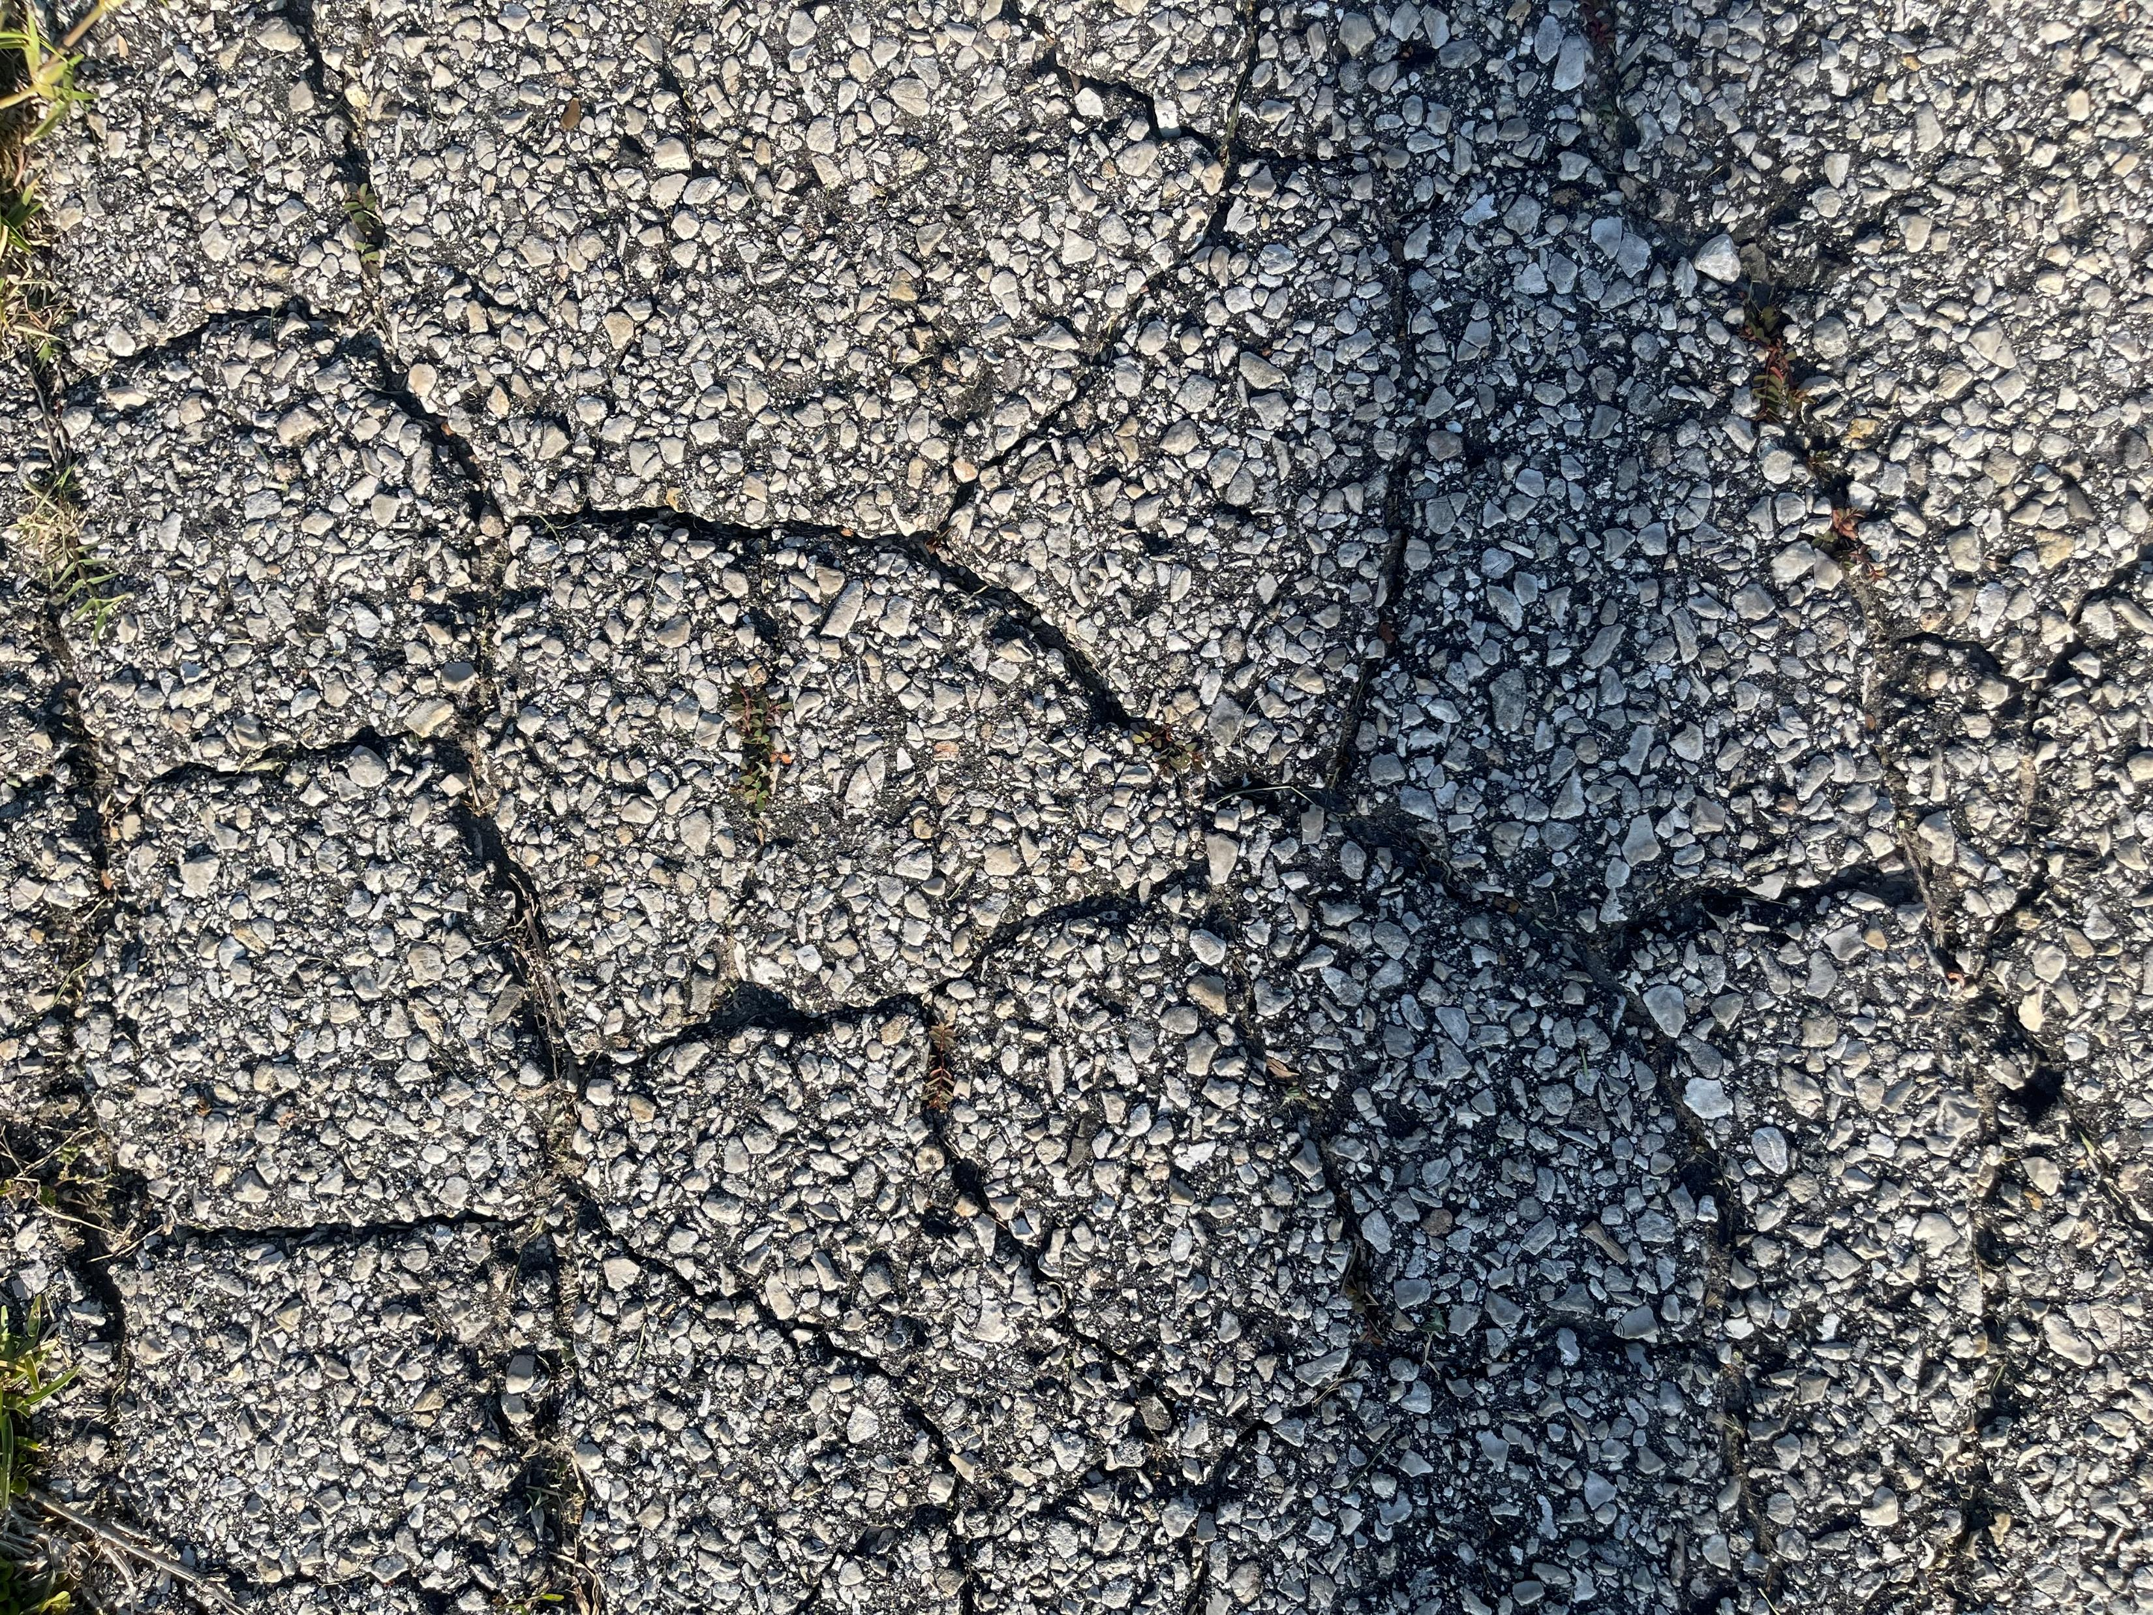
Storing Data
Before reding the data (image) in python, the images were stored into two different folders (to be used for binary classification of road condition)
Uncracked Road Surface
Cracked Road Surface

Slide 6
Steps for CNN modeling
Reading/loading dataset in python
Splitting training/testing dataset
Developing a CNN model
Compiling the model
Fitting the model for training dataset
Evaluating the model for testing dataset

Slide 7


Preprocessing image
1 Resize image
ensure all images in a dataset have the same dimensions (necessary for training model efficiently)
reduce its size while preserving its aspect ratio (useful for memory-intensive large images)
size of image: large enough to preserve the details of the image and small enough to reduce memory usage and processing time
2. Convert image Color
RGB standard color space for image
ensures that the colors in the image are displayed correctly when viewed on a monitor
Ensures compatibility with algorithms and libraries.

Slide 8
Reading image data
Image stored in different directory read as cracked and uncracked images using python, output: an array of preprocessed images
Preprocessed image stores in a list ‘image’, then converted to a NumPy array
Normalizing the pixel values (divided by 255 to get range of [0,1])
Functions used:
load_and_preprocess_images : to load and process image data
os.listdir : to get a list of all the files in the given directory
cv2.imread : to read image file
cv2.resize : to resize image to 256*256 pixels
cv2.cvtColor: to convert the image from BGR to RGB color space

Slide 9

Train test split for CNN model
“train_test_split()” function from “sklearn.model_selection”
Preprocessed image are combined into single numpy array ‘X’ (stacked vertically)
Another array ‘Y’ containing the lables of each image in ‘X’ and presented in binary value (1- cracked image, 0 – uncracked)
X, Y arrays are split into ‘X_train, X_test, y_train, y_test’, where 15% of data is stoored for testing
Random sampling is done for training and testing by using ‘Random_state ’ (1234)

Slide 10
Model Architecture
Sequential Model for Image classification (binary)
4 convolutional layers with 2 fully connected layer (dense)
First layer
has 16 filters, kernel size of 3*3, activation function: ReLU (Rectified Linear Unit)
MaxPooling layer size: 2*2
Input shape : 256*256 (image width and height if 256 pixels), 3 color channel (RGB)
Second layer
has 16 filters, kernel size of 3*3, activation function: ReLU
MaxPooling layer size: 2*2
Third and fourth layer
has 32 filters, kernel size of 3*3, activation function: ReLU
MaxPooling layer size: 2*2
Flatten layer
Converts output of convolutional layers into a single vector
Dense layer
First layer: 32 neurons and Relu activation function
Second layer: sigmoid activation function

Slide 11
Model Compilation and Training
Model compiled using Keras ‘model.compile()’
Optimizer
adam : adopts learning rates during testing based on gradient of loss function
Loss function
Objective of minimizing loss during training model in each epoch
Binary_crosstropy: measures the difference between predicted and actual output probabilities and minimize the binary cross-entropy loss function
Metrics
To evaluate the performance of model during training and testing
Accuracy: measures proportion of correctly classified image form the dataset

Slide 12
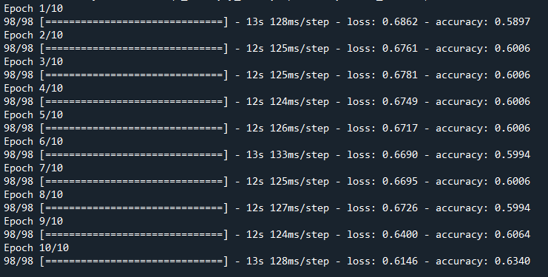
Model Fitting
Defined model is fitted for the training dataset
for 10 epoch
batch size = 16 image at a time
After each epoch, model evaluates its performance on training dataset and updates its weights and biases.

Slide 13
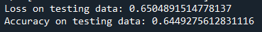
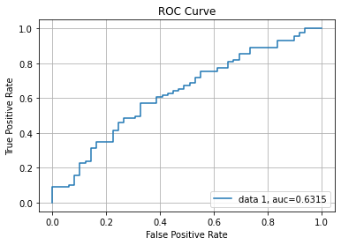
Model Evaluation
Loss and Accuracy:
most common way to present the results of a CNN model
shows how well the model is learning the patterns in the training data and how well it generalizes to unseen validation data.
Receiver Operating Characteristic (ROC) Curve:
plot to shows the true positive rate (TPR) against the false positive rate (FPR) for different the (binary classification) model
useful way to evaluate the performance of the model on imbalanced datasets

Slide 14
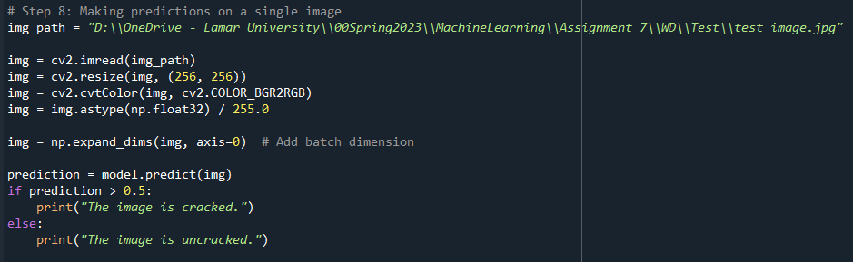
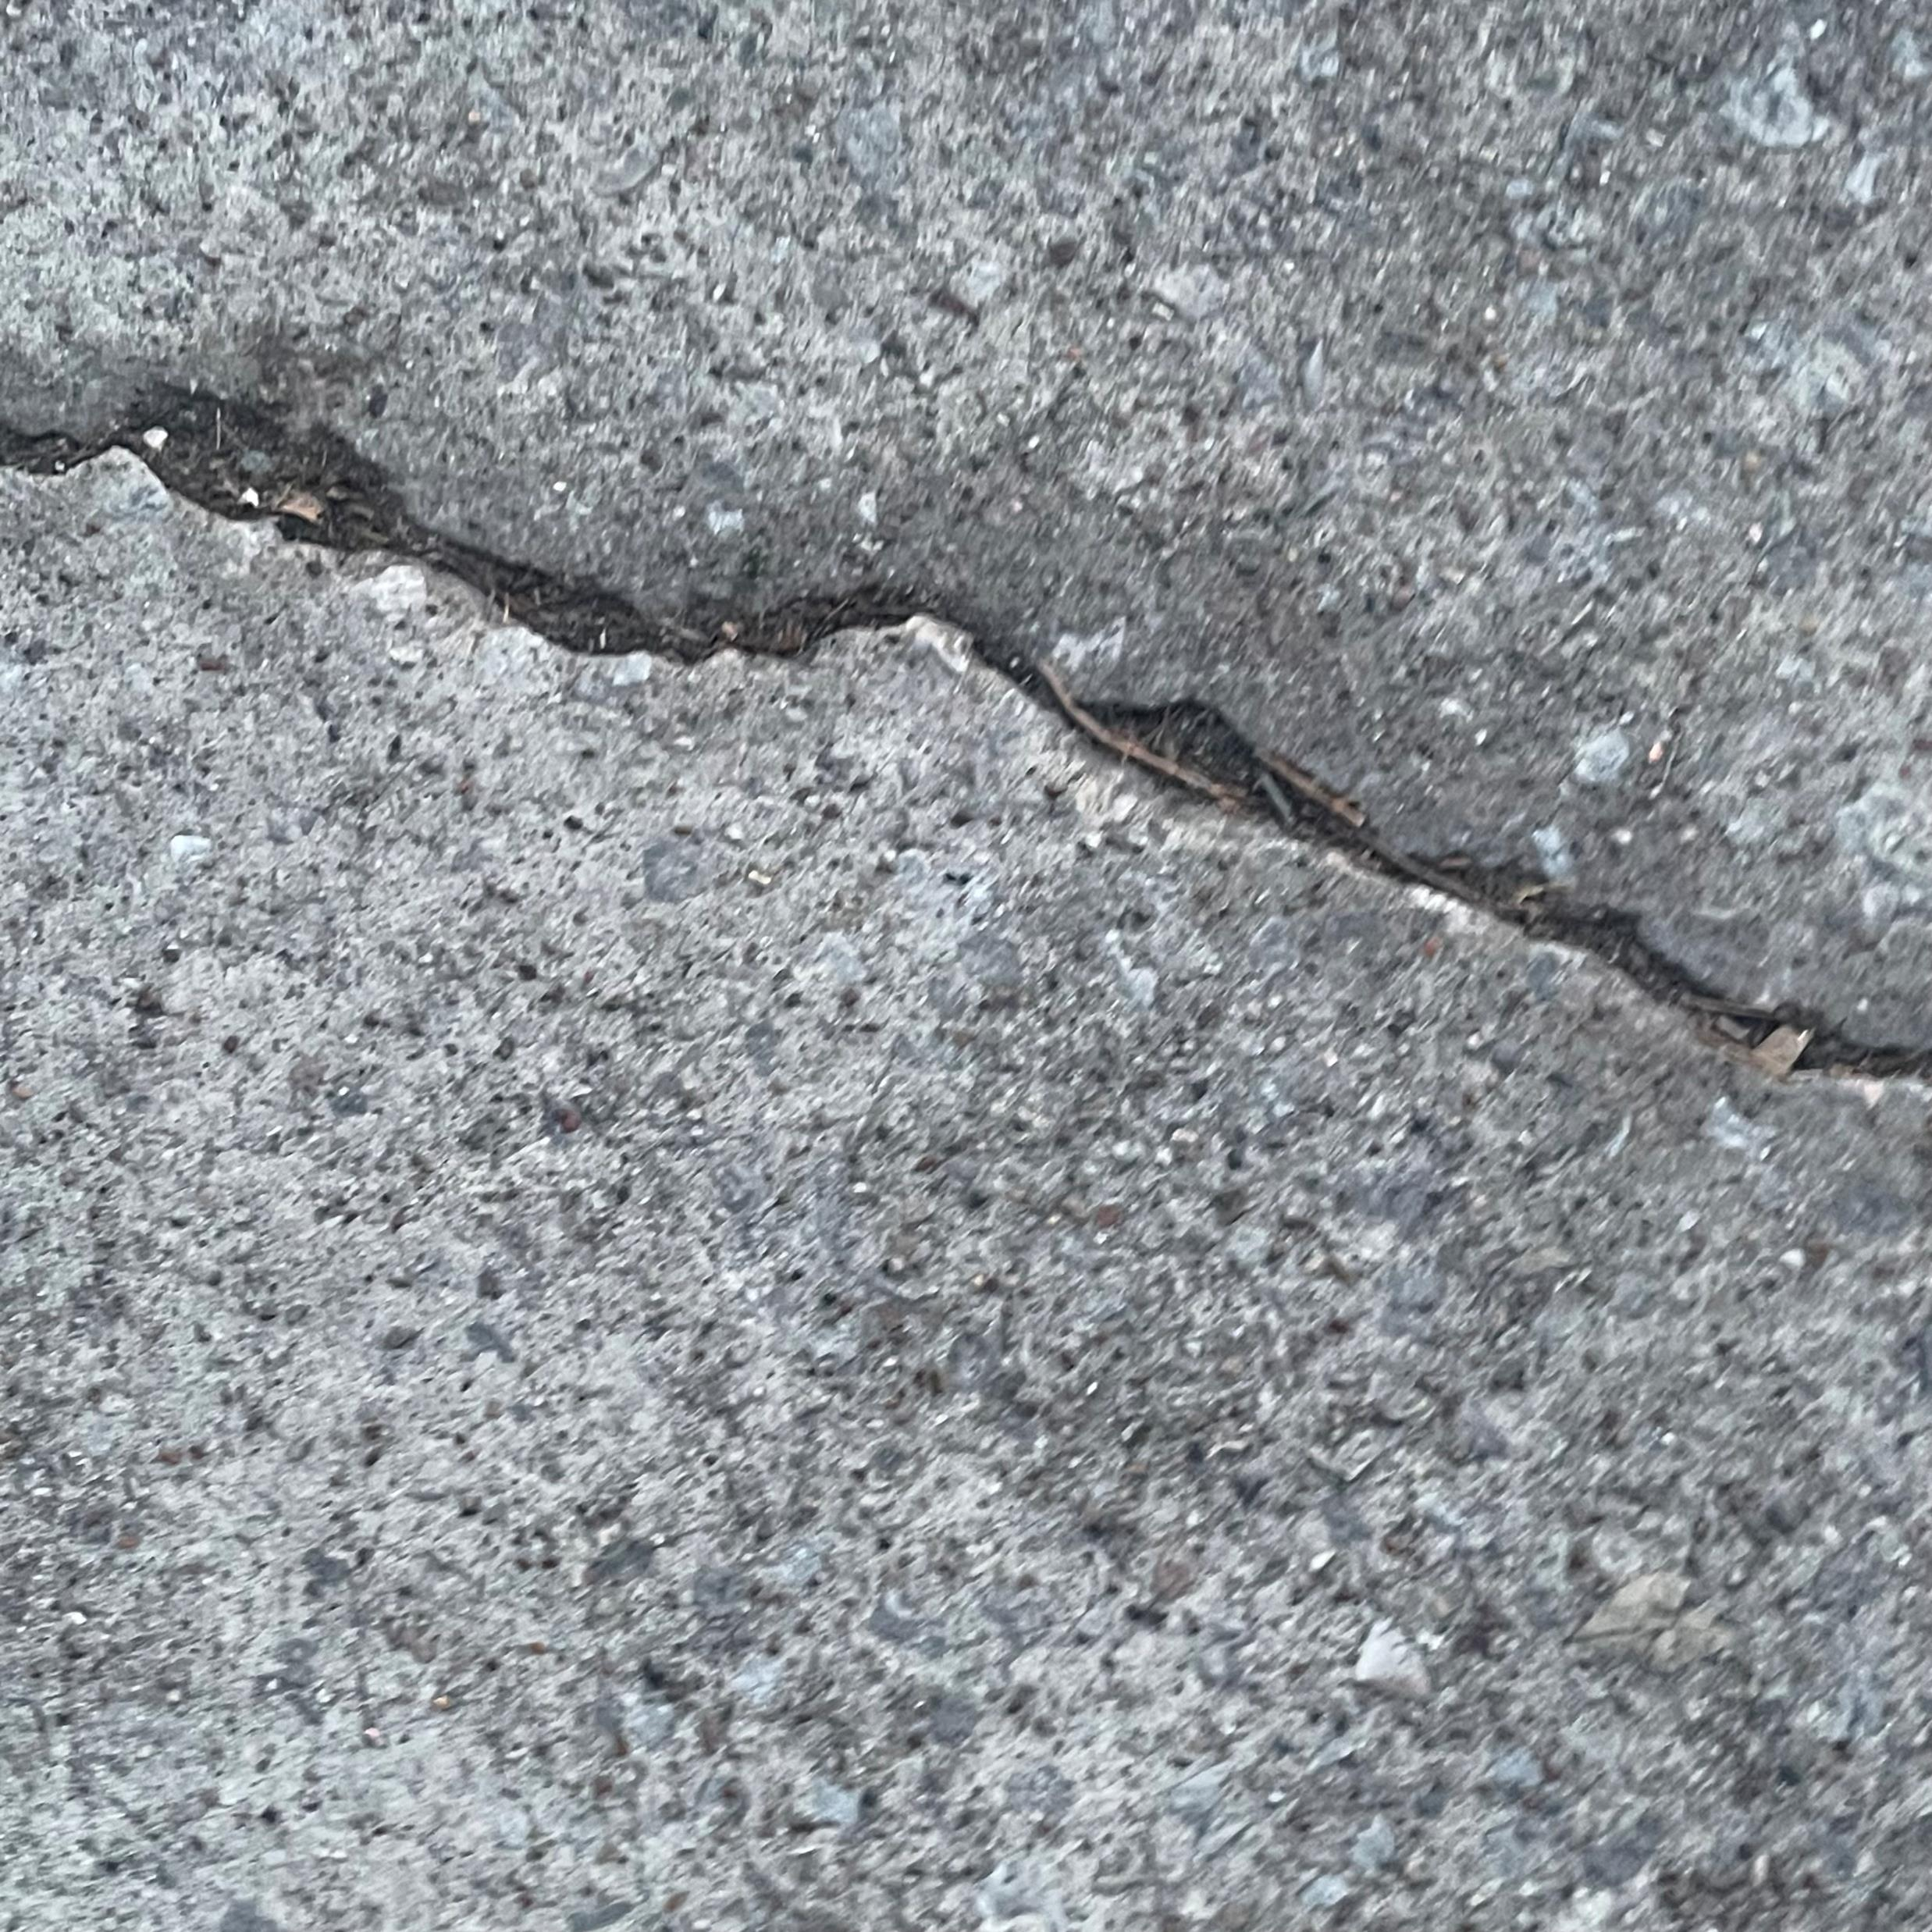
Prediction using the model
Python Code used for making prediction
Input image for making prediction using developed CNN model
Outcome of CNN modeling for input image

Slide 15
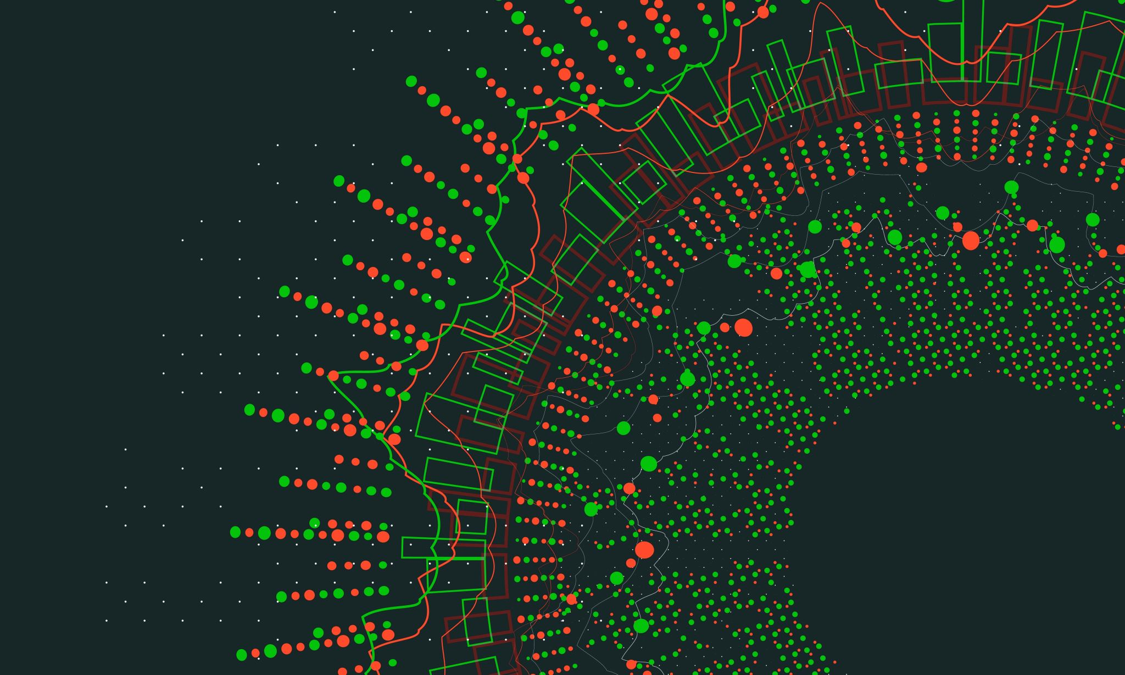
Thank You

